Slide 1
Create a Report Server Project
Lecturer: Ngo Huy Bien
Software Engineering Department
Faculty of Information Technology
VNUHCM - University of Science
Ho Chi Minh City, Vietnam
nhbien@fit.hcmus.edu.vn

Slide 2

Objectives

Slide 3

Contents

Slide 4

References
Brian Larson (2017). Microsoft SQL Server 2016 Reporting Services. McGraw-Hill Education.

Slide 5
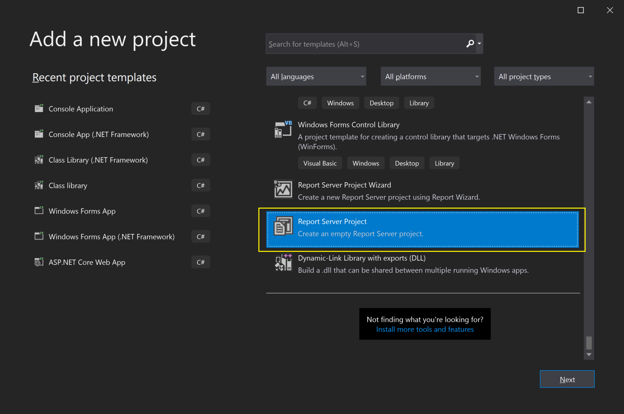
1. Create a Report Server Project
When using SSDT or Visual Studio, multiple reports are grouped together for you inside a project.

Slide 6
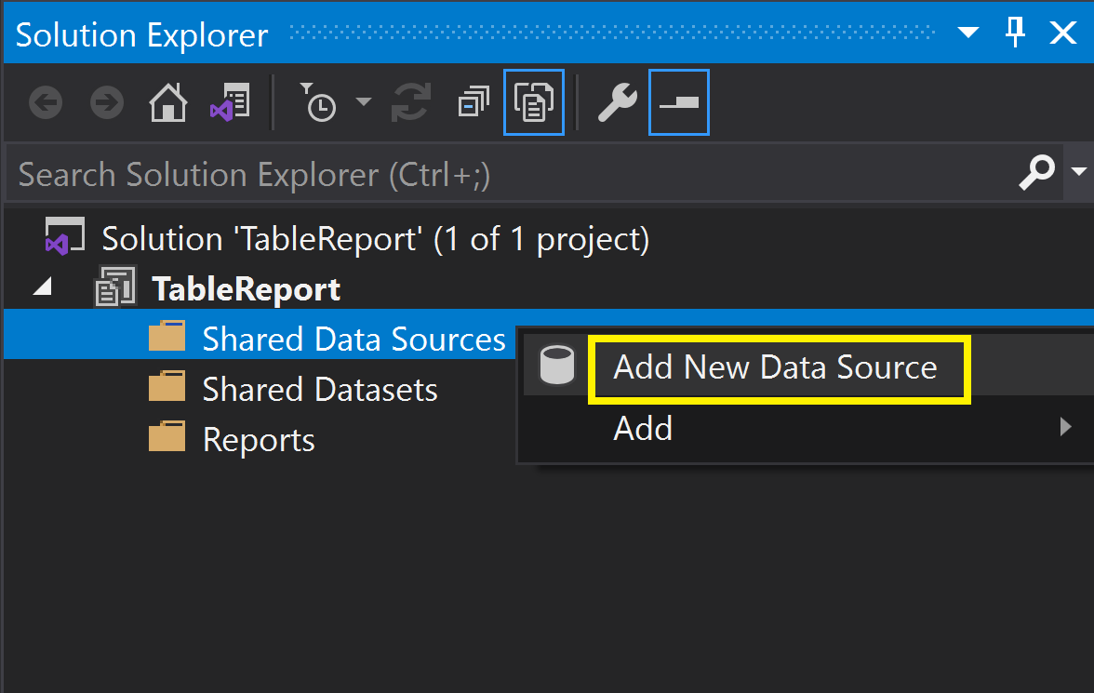
2. Create a Shared Data Source (I)

Slide 7
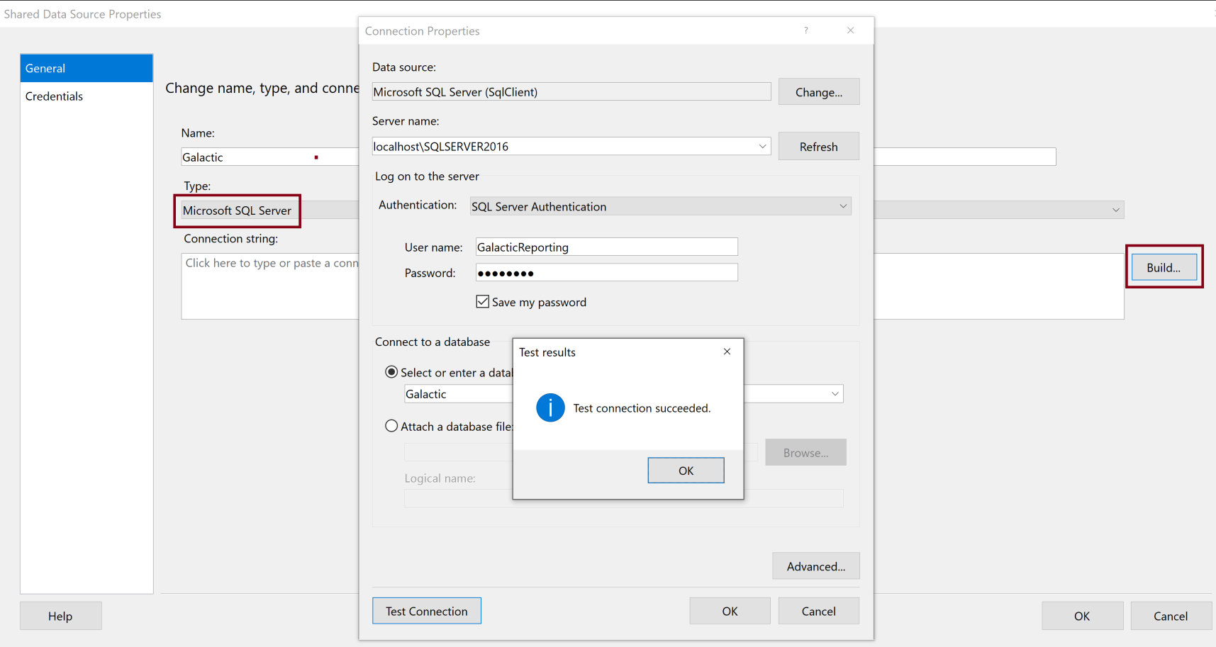
3. Create a Shared Data Source (II)

Slide 8
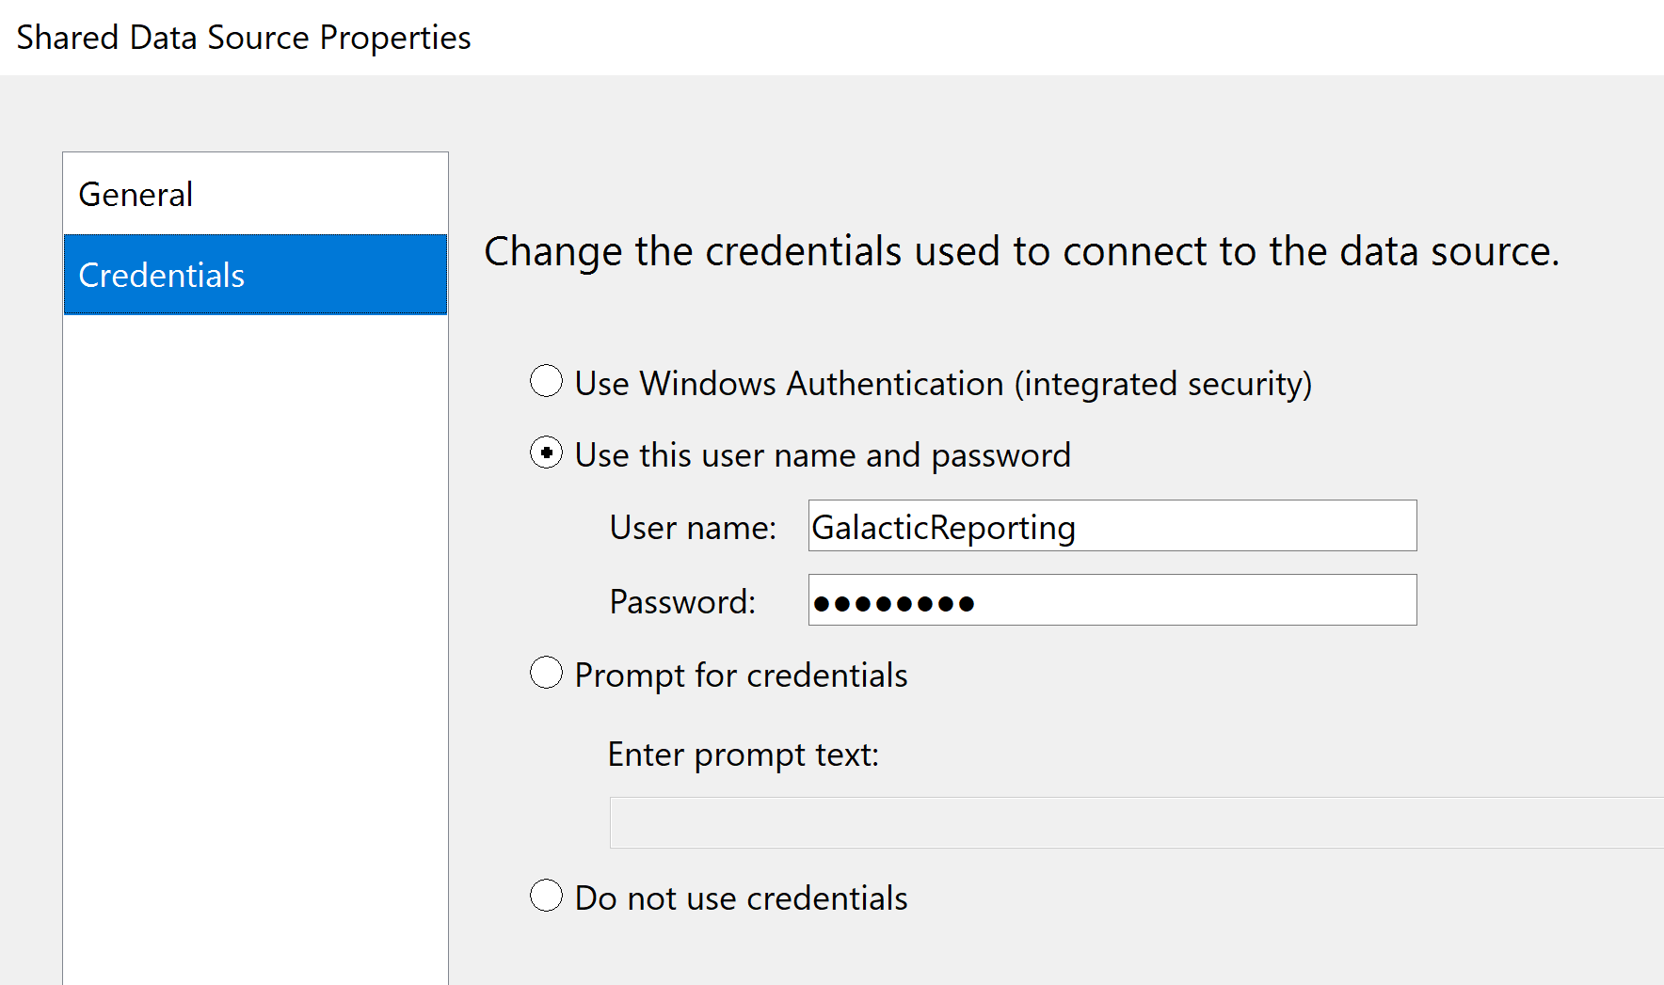
4. Create a Shared Data Source (III)

Slide 9
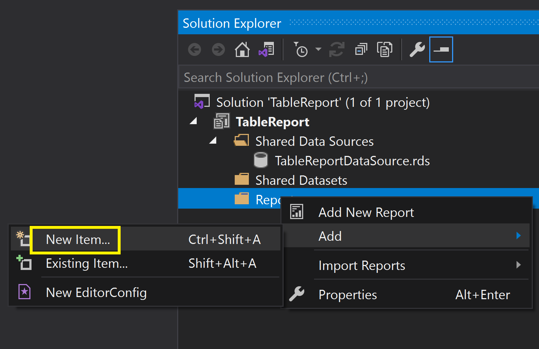
5. Create an Empty Report (I)

Slide 10
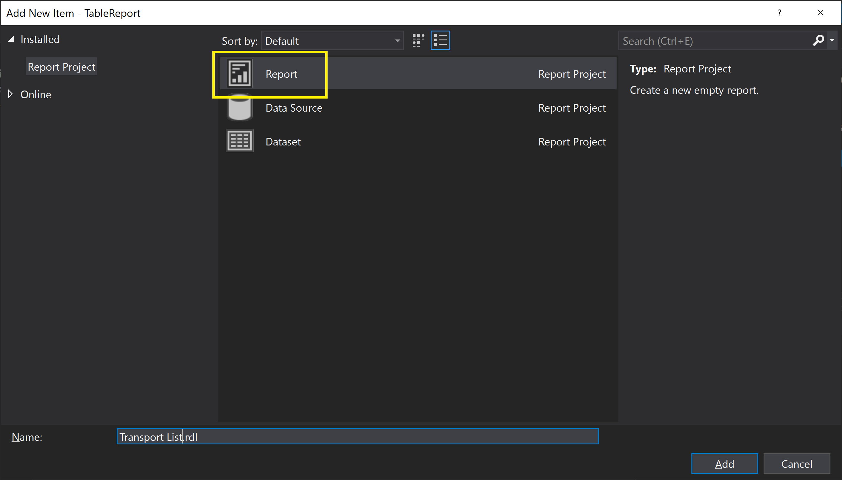
6. Create an Empty Report (II)

Slide 11
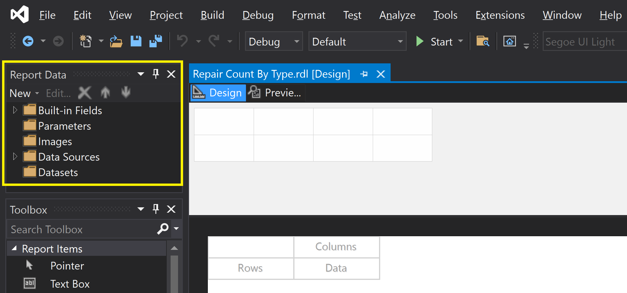
7. Open Report Data Pane
Turn on Caps Lock
CTRL + ALT + D

Slide 12
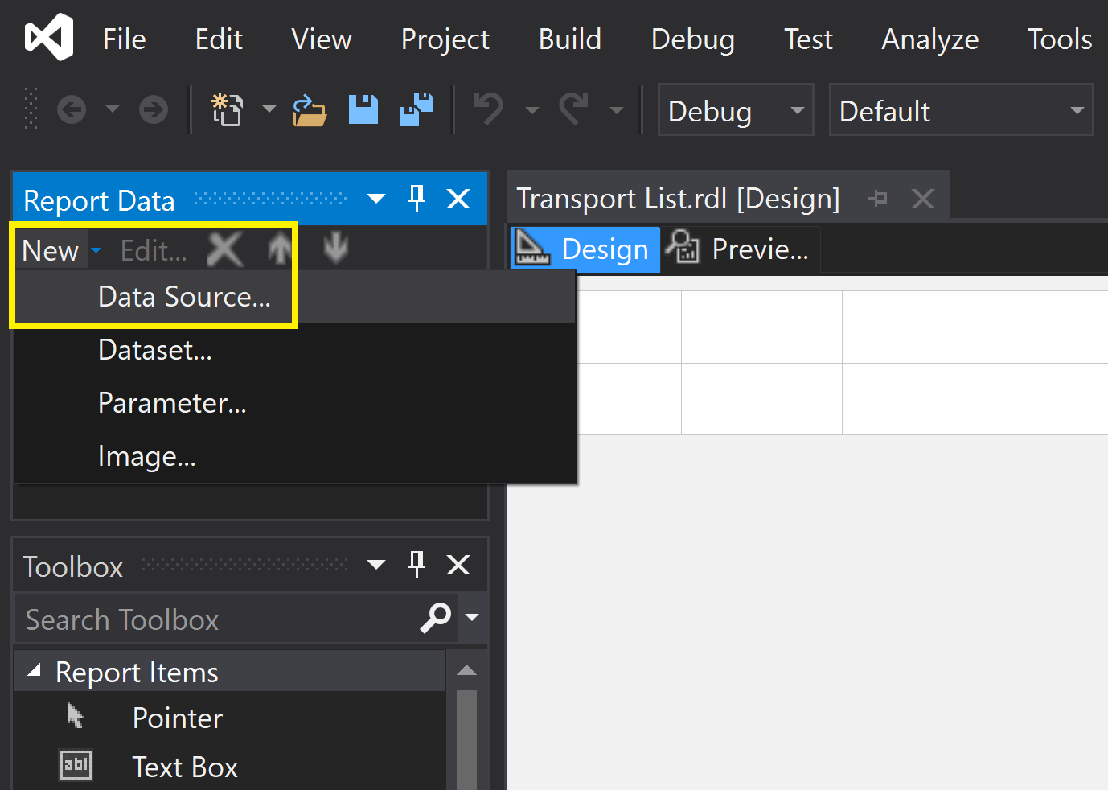
8. Add a Report Data Source (I)
This data source belongs to the report.

Slide 13
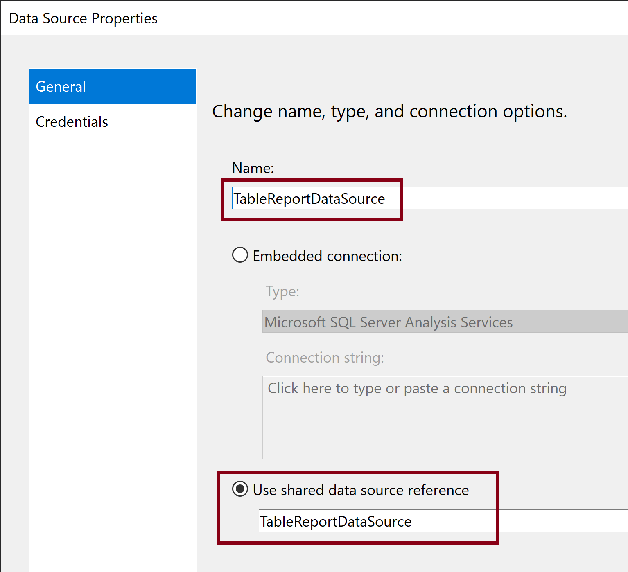
9. Add a Report Data Source (II)

Slide 14
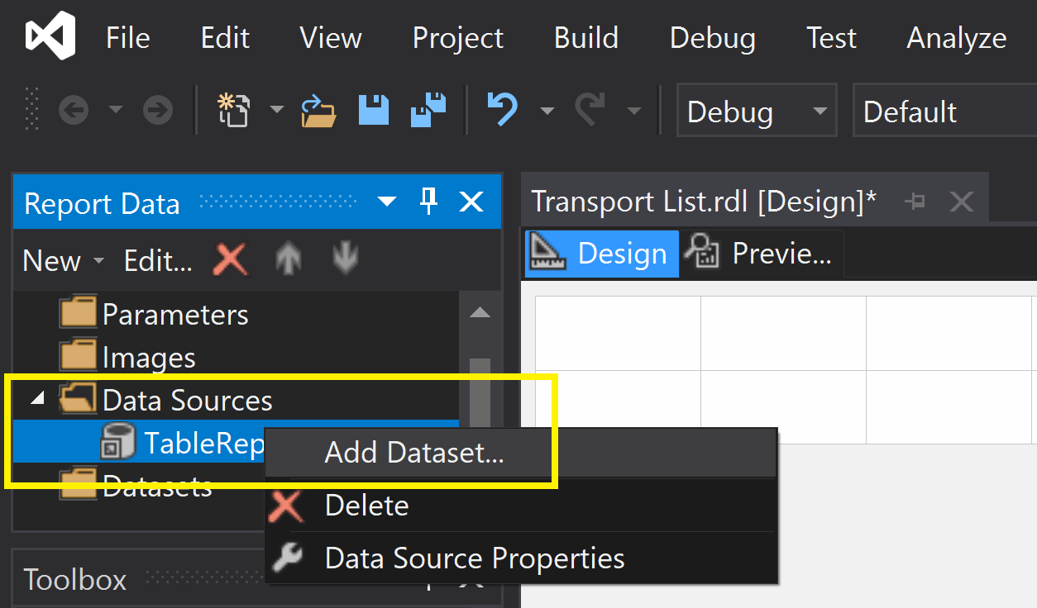
10. Add a Data Set (I)
This data set belongs to the report.

Slide 15
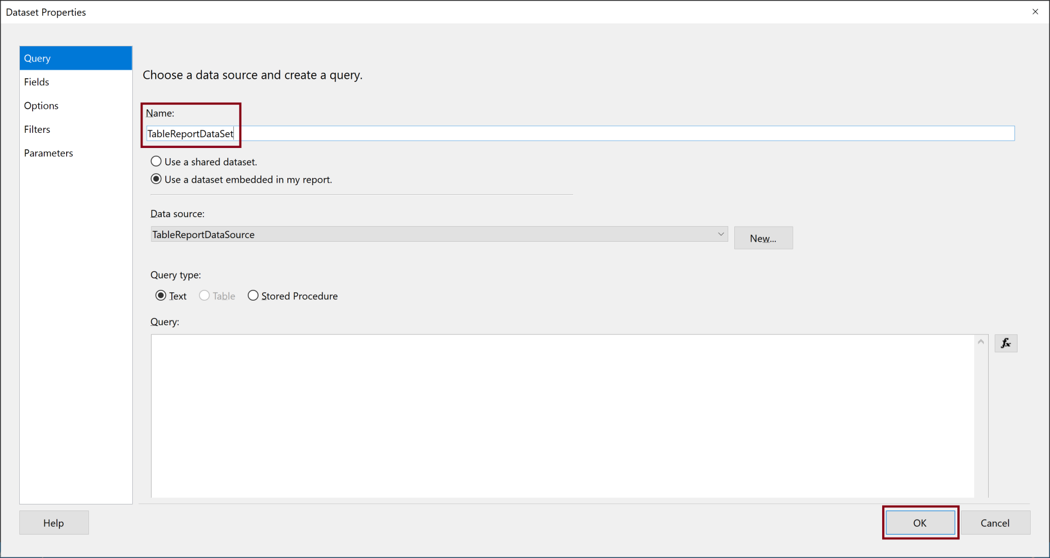
11. Add a Data Set (II)

Slide 16
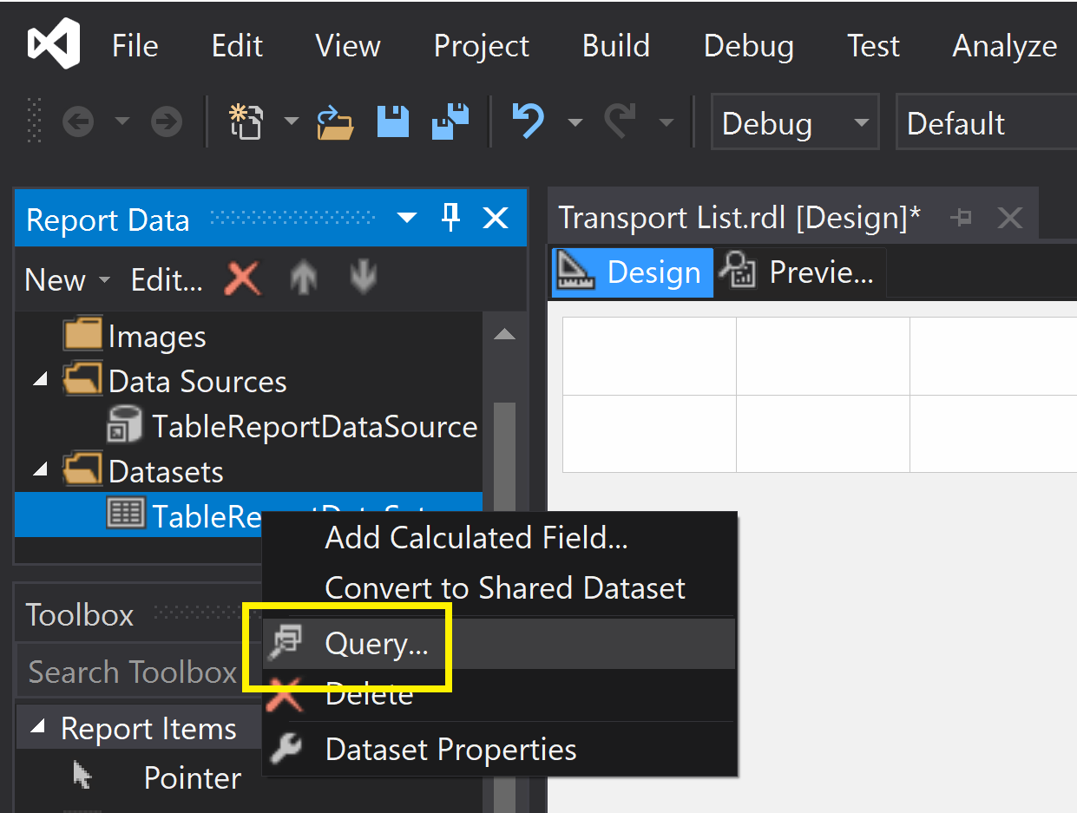
12. Open Query Designer

Slide 17
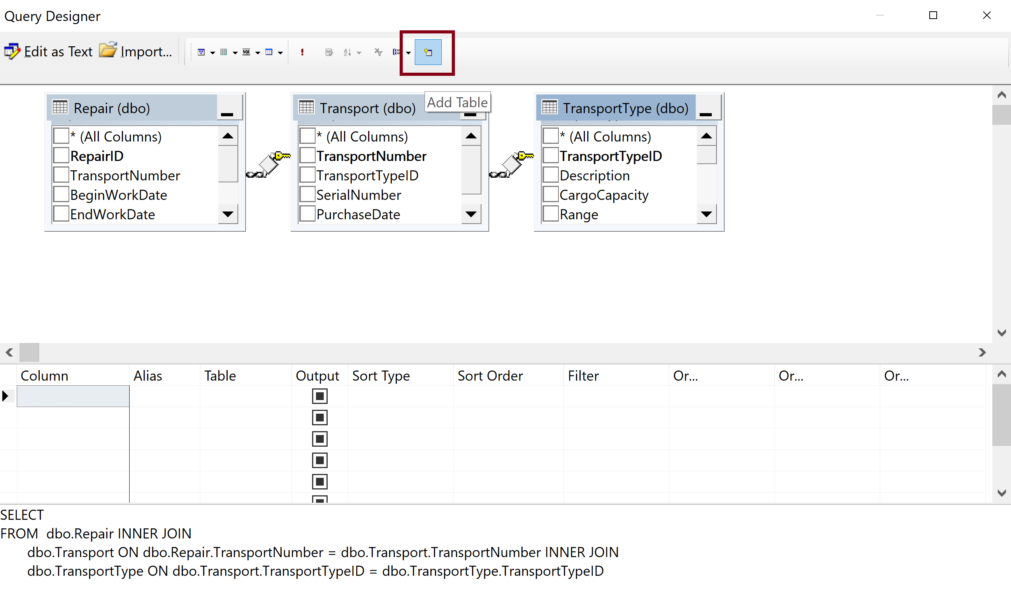
13. Create a Query (I)

Slide 18
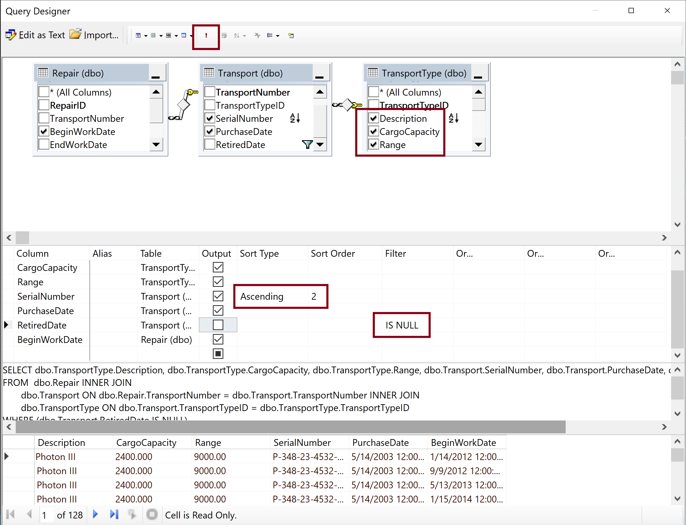
14. Create a Query (II)

Slide 19
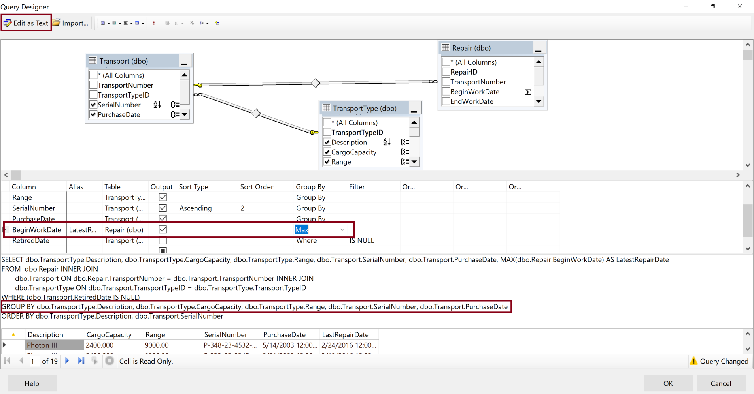
15. Create a Query (III)
Right-click in the diagram pane of the Graphical Query Designer screen.
Select Add Group By from the context menu TWICE.
Click Execute button.

Slide 20
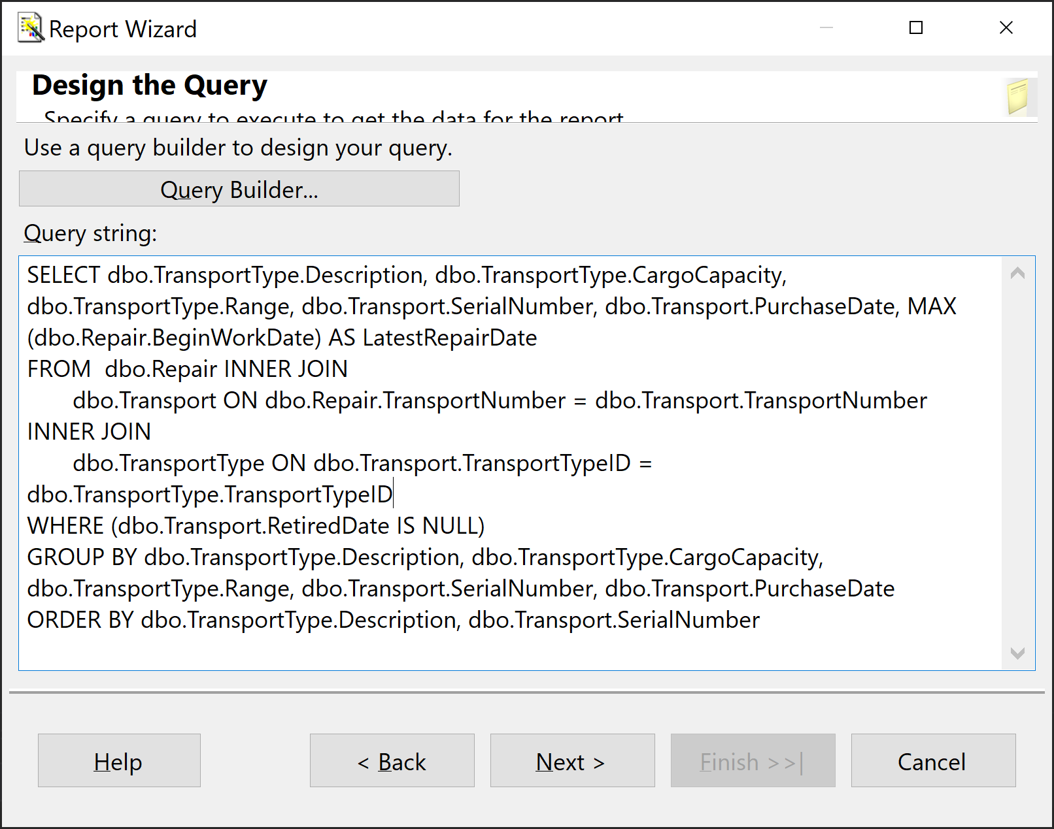
16. Create a Query (IV)

Slide 21
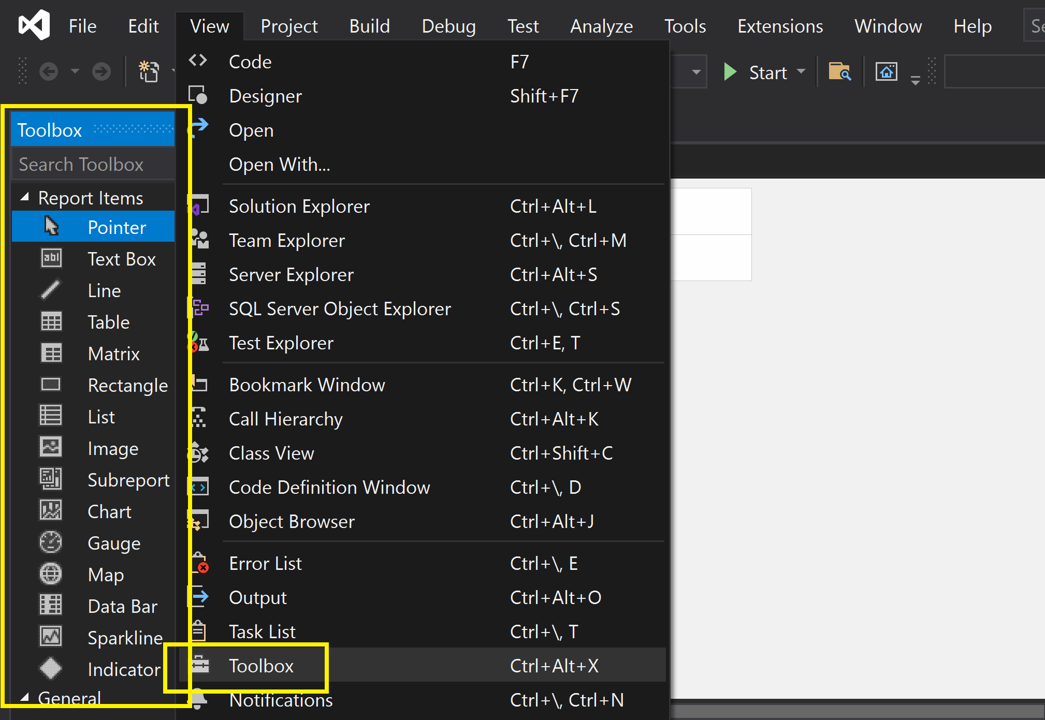
17. Open Toolbox

Slide 22
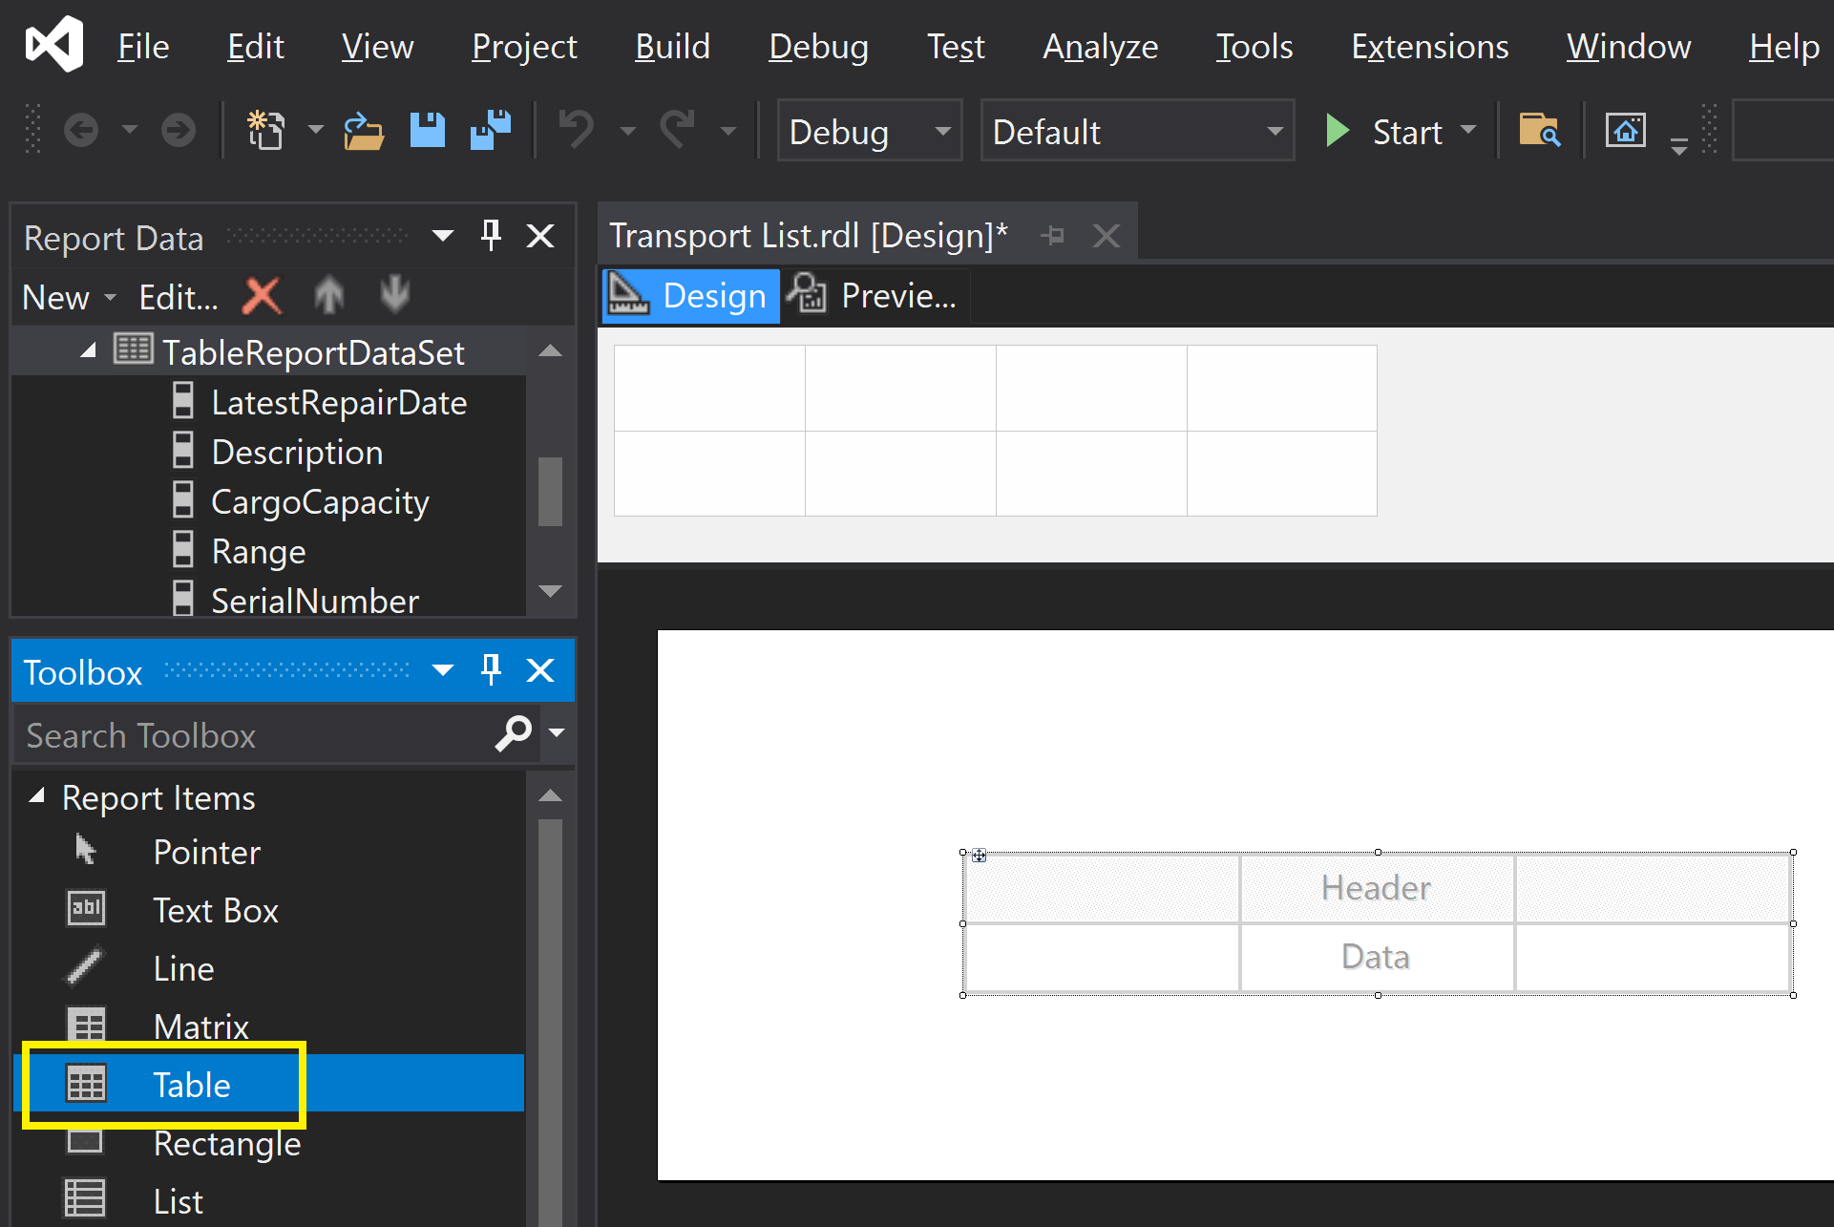
18. Add a Table Report Item

Slide 23
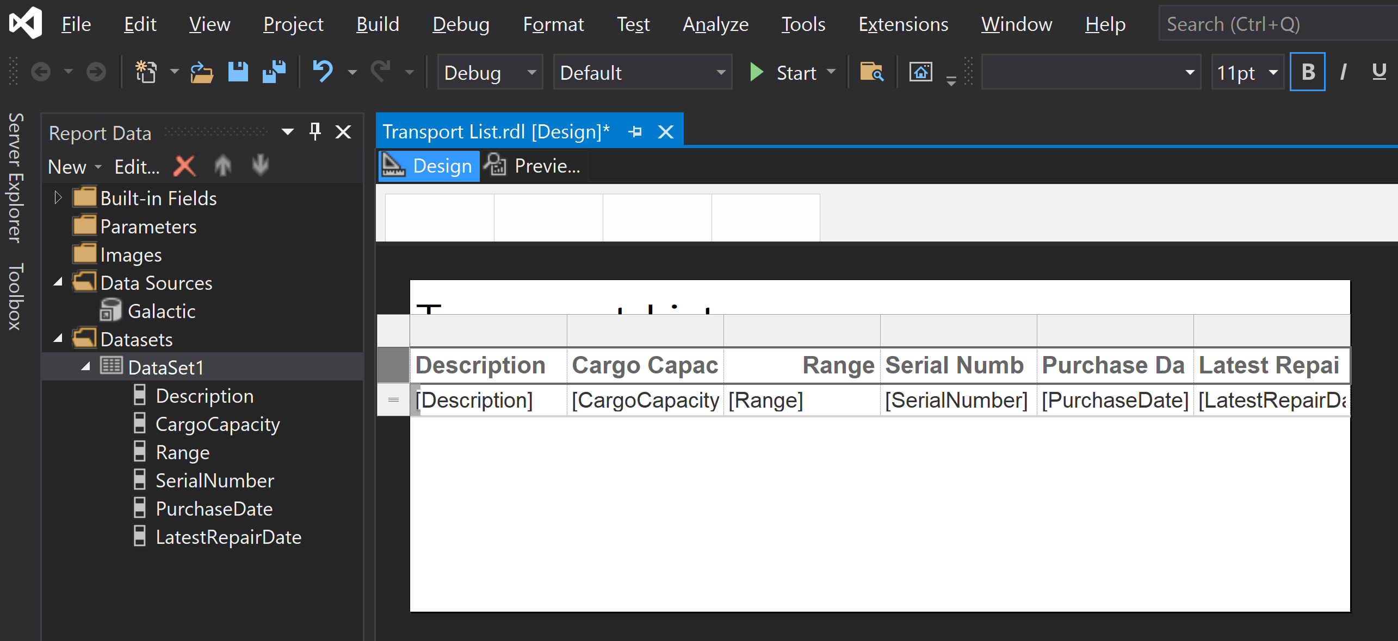
19. Edit the Table Report

Slide 24
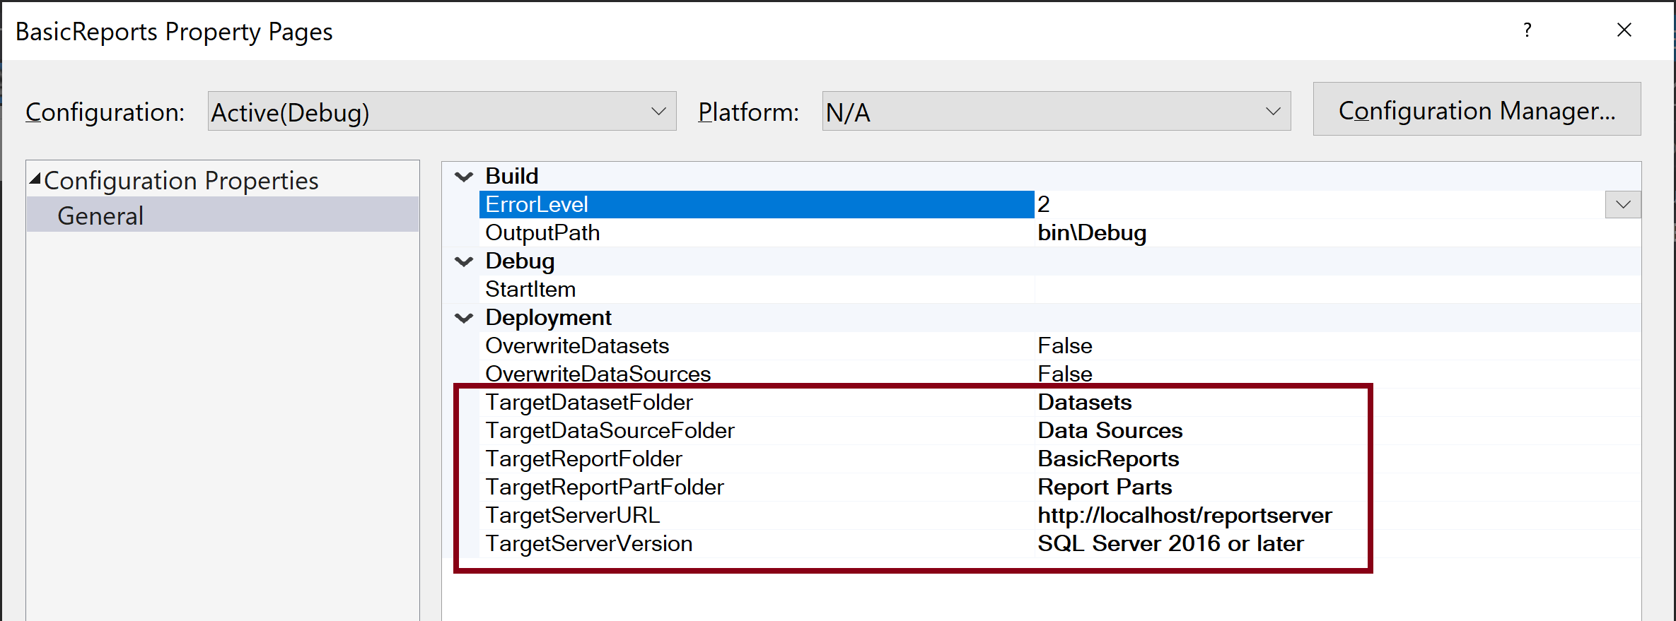
20. Edit Deployment Information
Right click a reporting project and select Properties.

Slide 25
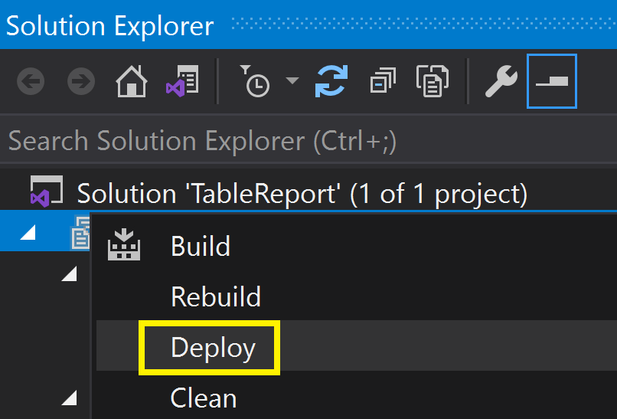
21. Deploy Report
Right click a reporting project and select Deploy.

Slide 26
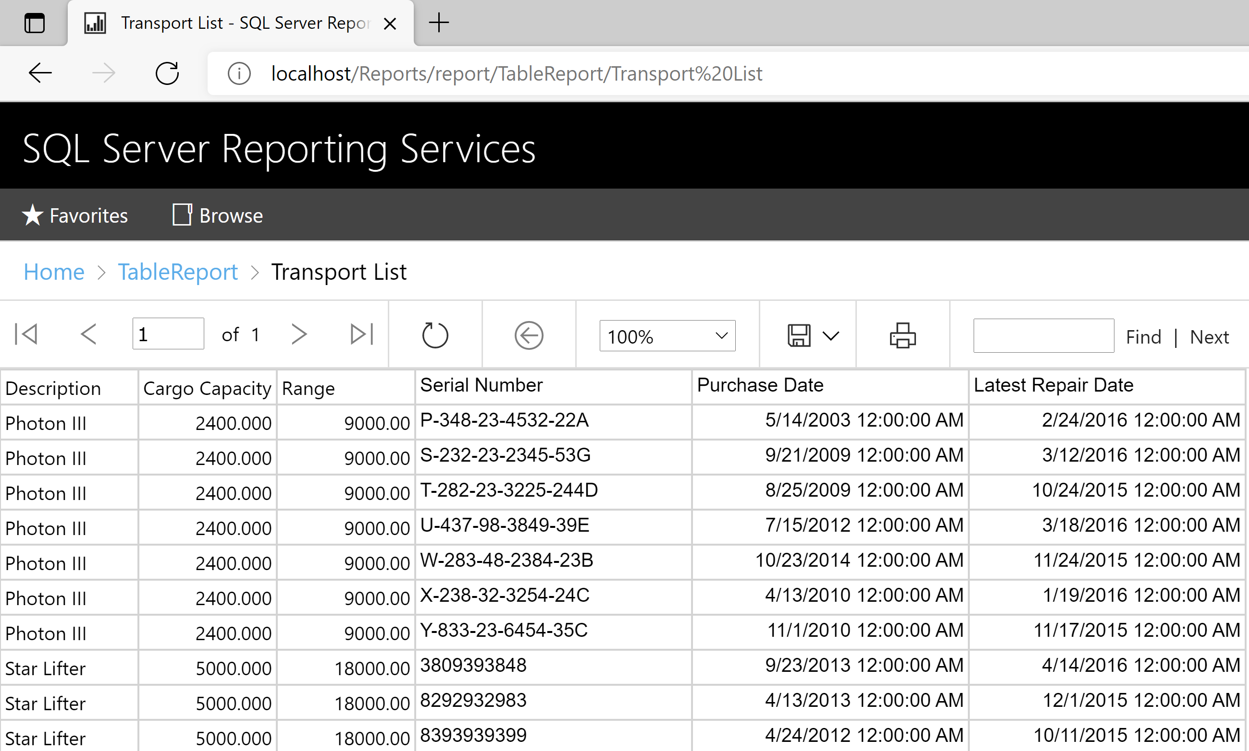
22. Test the Deployed Report
http://localhost/Reports/report/TableReport/Transport%20List

Slide 27

Thank You & See You Again

